Slide 1
Air Quality Sensor
By: Aadi Padmawar

Slide 2
Objective
Collect data on the air particles in the air, and perform different methods to find averages and other statistics

Slide 3
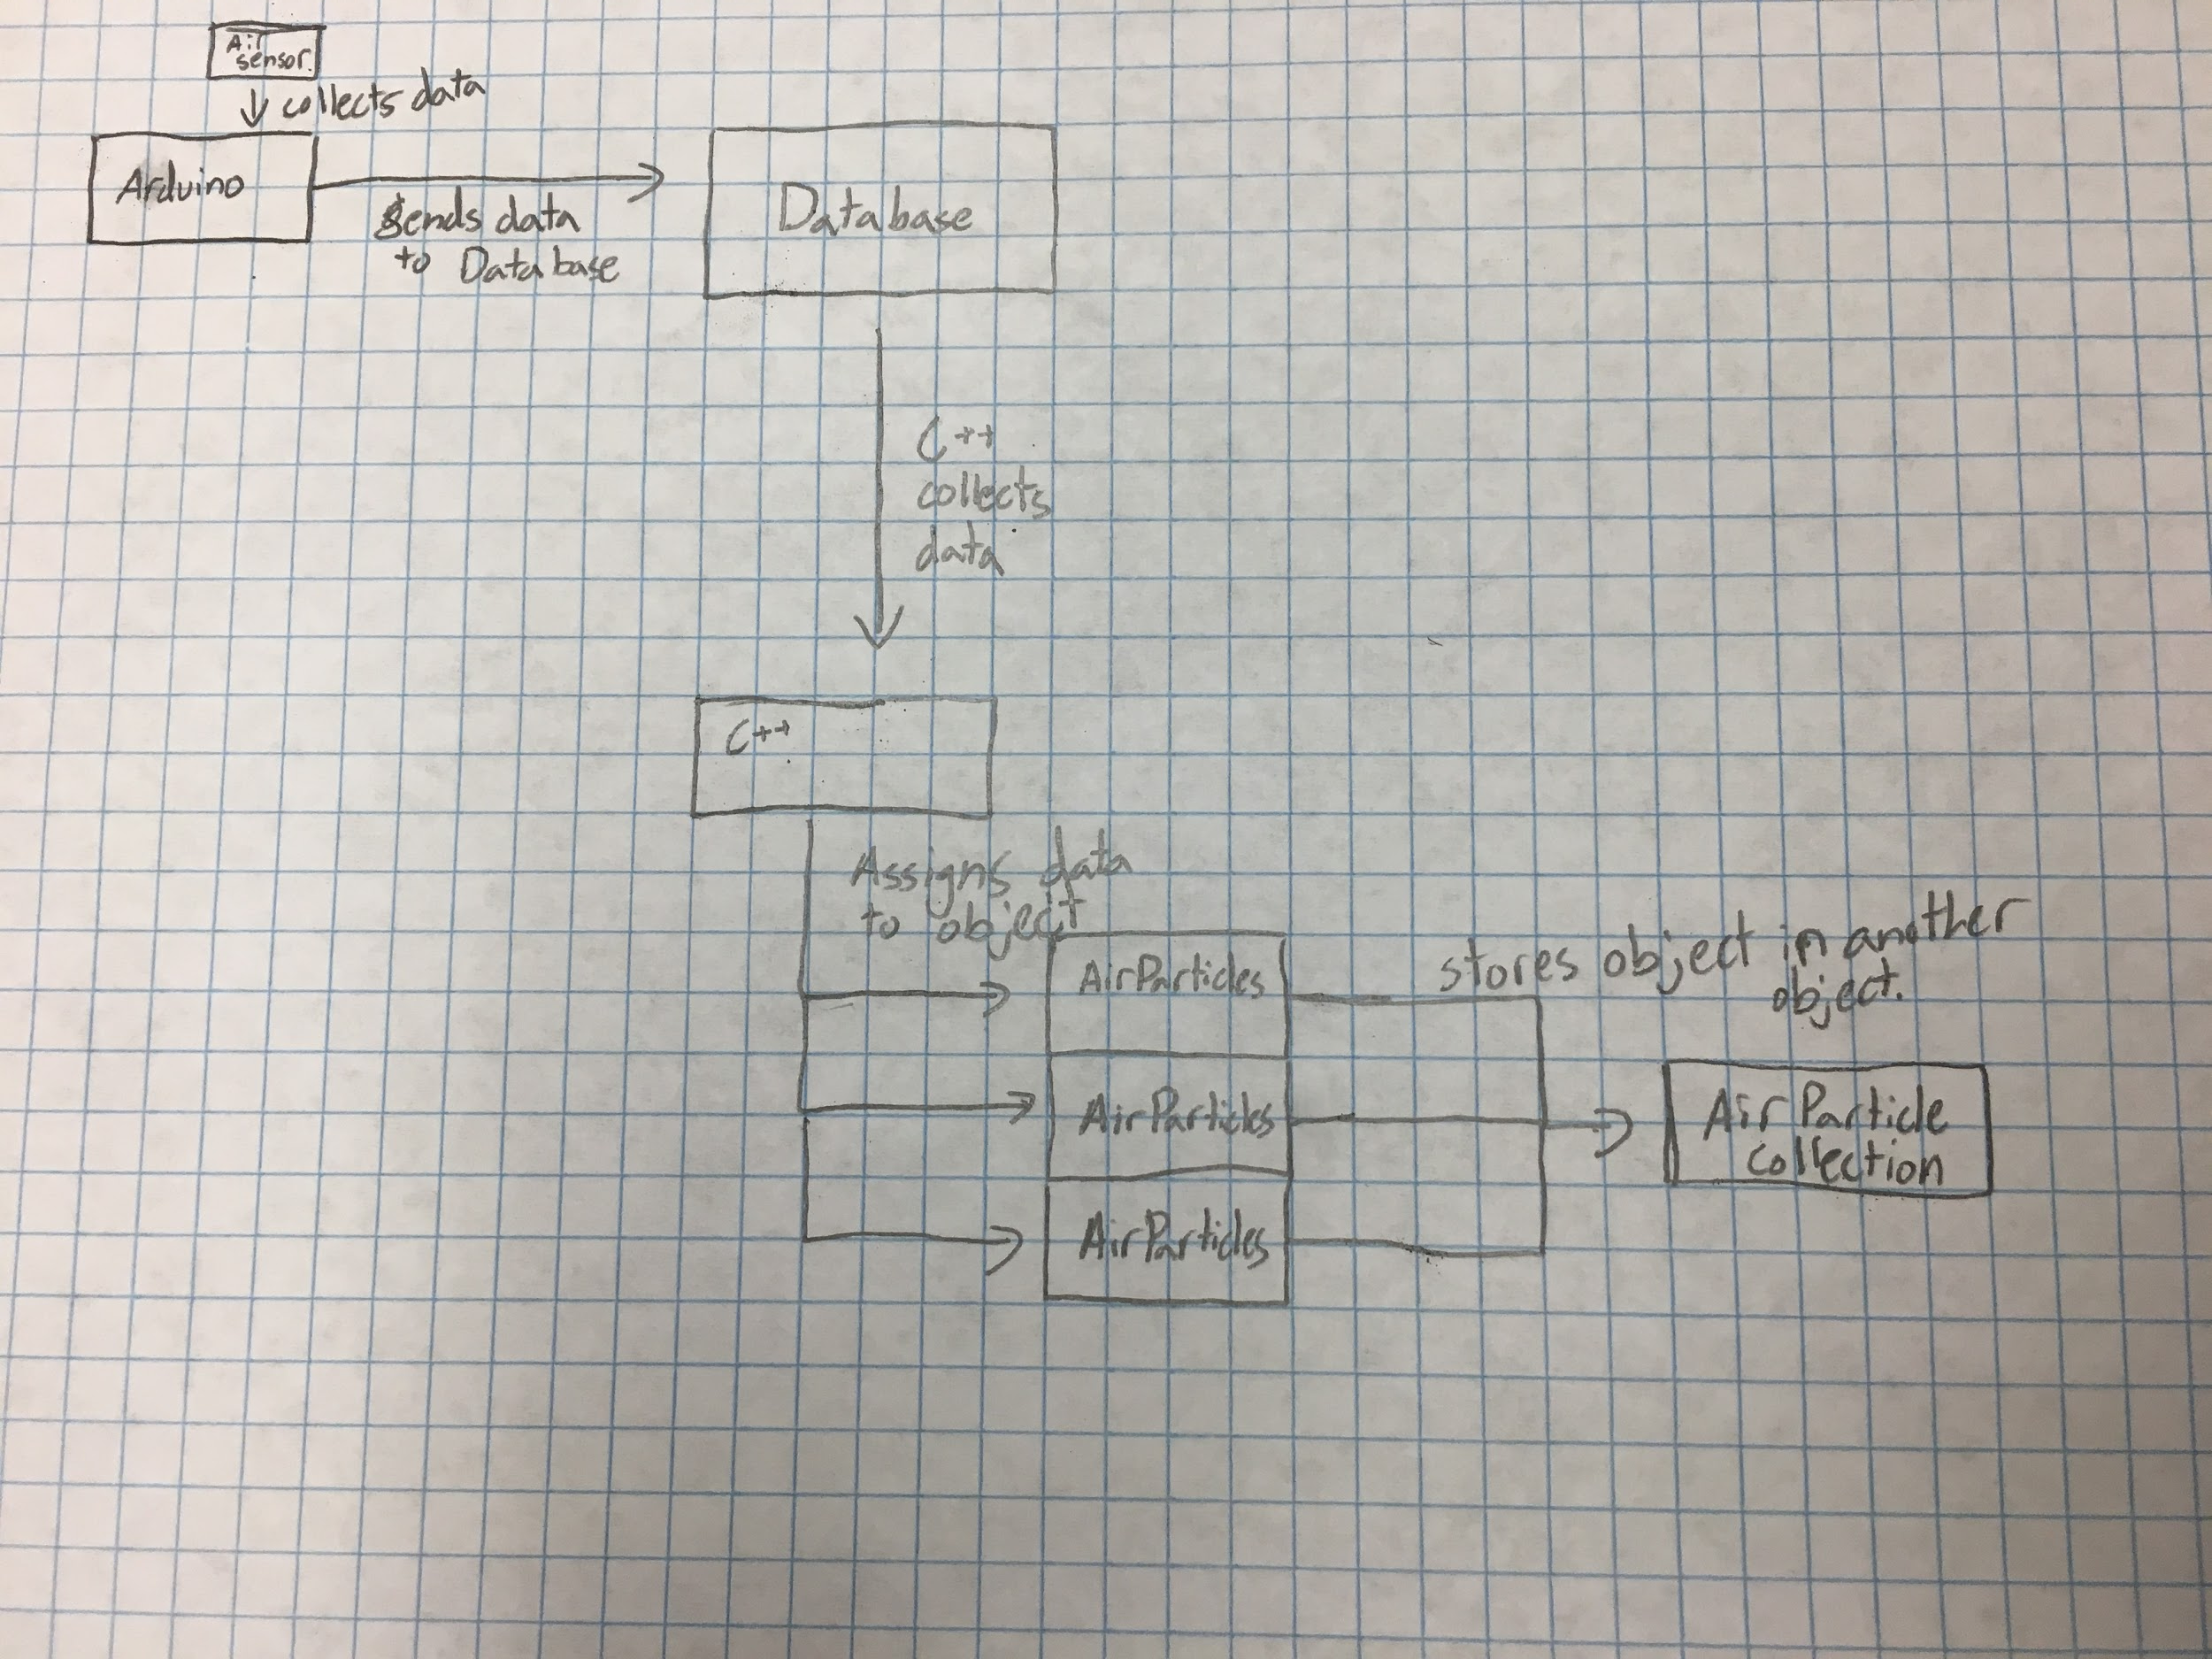
Code Logic

